Slide 1

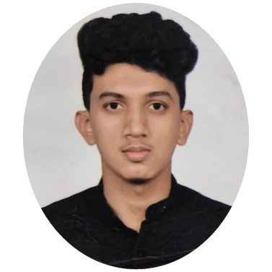





Shashank N
Education and certificates
Bachelor of Technology Electrical and Electronics : 2019 - 2022
Analyst/Software Engineer
Skills Spring Boot Spring MVC
JPA CRUD/JPA MONGODB
Visual code
Base Location:Bangalore
Email ID: Shashank.n@capgemini.com
_{Mobile No:8884059091}
Grade:A4
Backend
Spring Boot/Spring Security MongoDB
REST-API
NodeJS
Strengths
A self learner hands on knowledge on Backend and front end. Good knowledge on Git and Github spring concept.Passionate about implementing and launching new projects.
Ready to learn new technologies and implement them to further improve my knowledge.
With a good communication skill always ready to work for the enrichment of knowledge.Upskilling of new skills and technology
working knowledge on Angular and Spring Boot Microservice.Implemented eureka server in case study
Achivement
Shopping Cart System Application
Completed case study of Shopping Cart System along with JWT authentication, Swagger and Billing System using Spring boot Microservices with Eureka Server. Semantic UI and Angular used for admin user interface.
Database
SQL database – MySQL
No SQL database – MongoDB
Placement Management Cell
Web Technologies
HTML5 CSS
Completed case study of placement management cell with crud operation and management of database in my SQL and worked on front and backend of placement cell
AddOns Github Maven Postman
Additional Details
Good Communication Skills
Analytical skill
https://github.com/account
Presentation Title | Author | Date © Capgemini 2017. All rights reserved | 1

